Slide 1
Conditions and Trends of the
Kansas High Plains Aquifer
USRSB Feed Sustainability Task Force Meeting
September 22, 2023
Kansas Geological Survey
University of Kansas

Slide 2
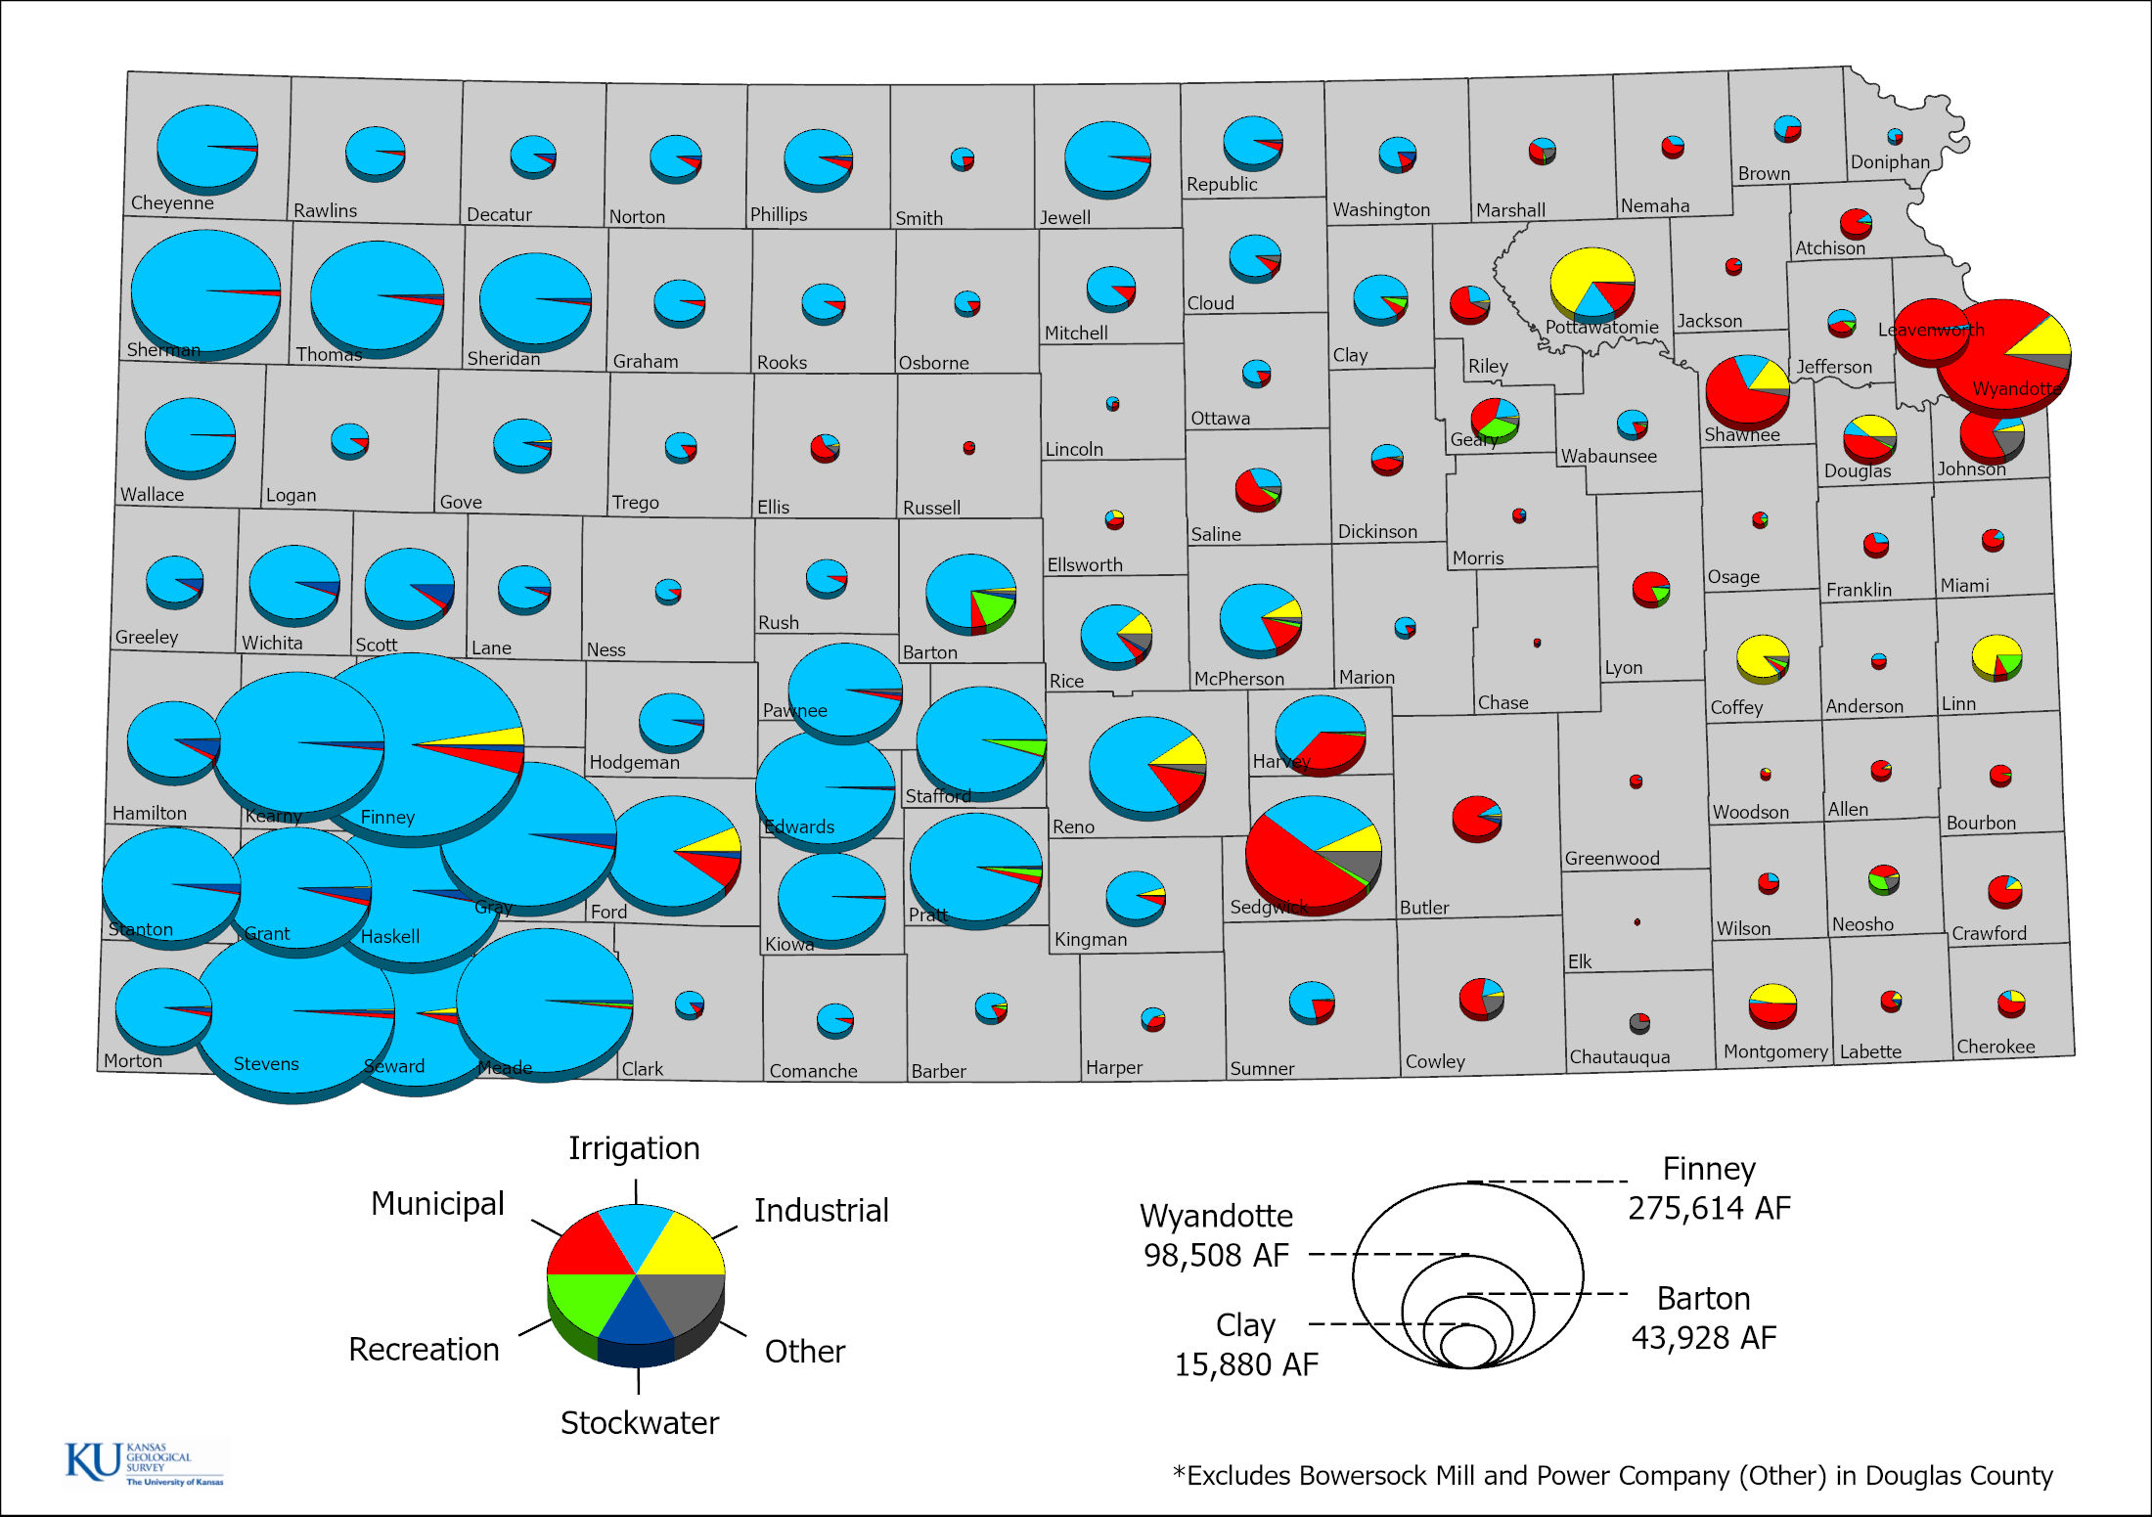
Average Reported Use Made of Water, 2012 to 2021
Eastern Kansas typically municipal and industrial uses
Irrigation dominates western and south-central Kansas
Stockwater uses, although smaller, are found in greater concentrations in southwest Kansas
Driven by precipitation, climate, and water availability
Kansas Geological Survey

Slide 3
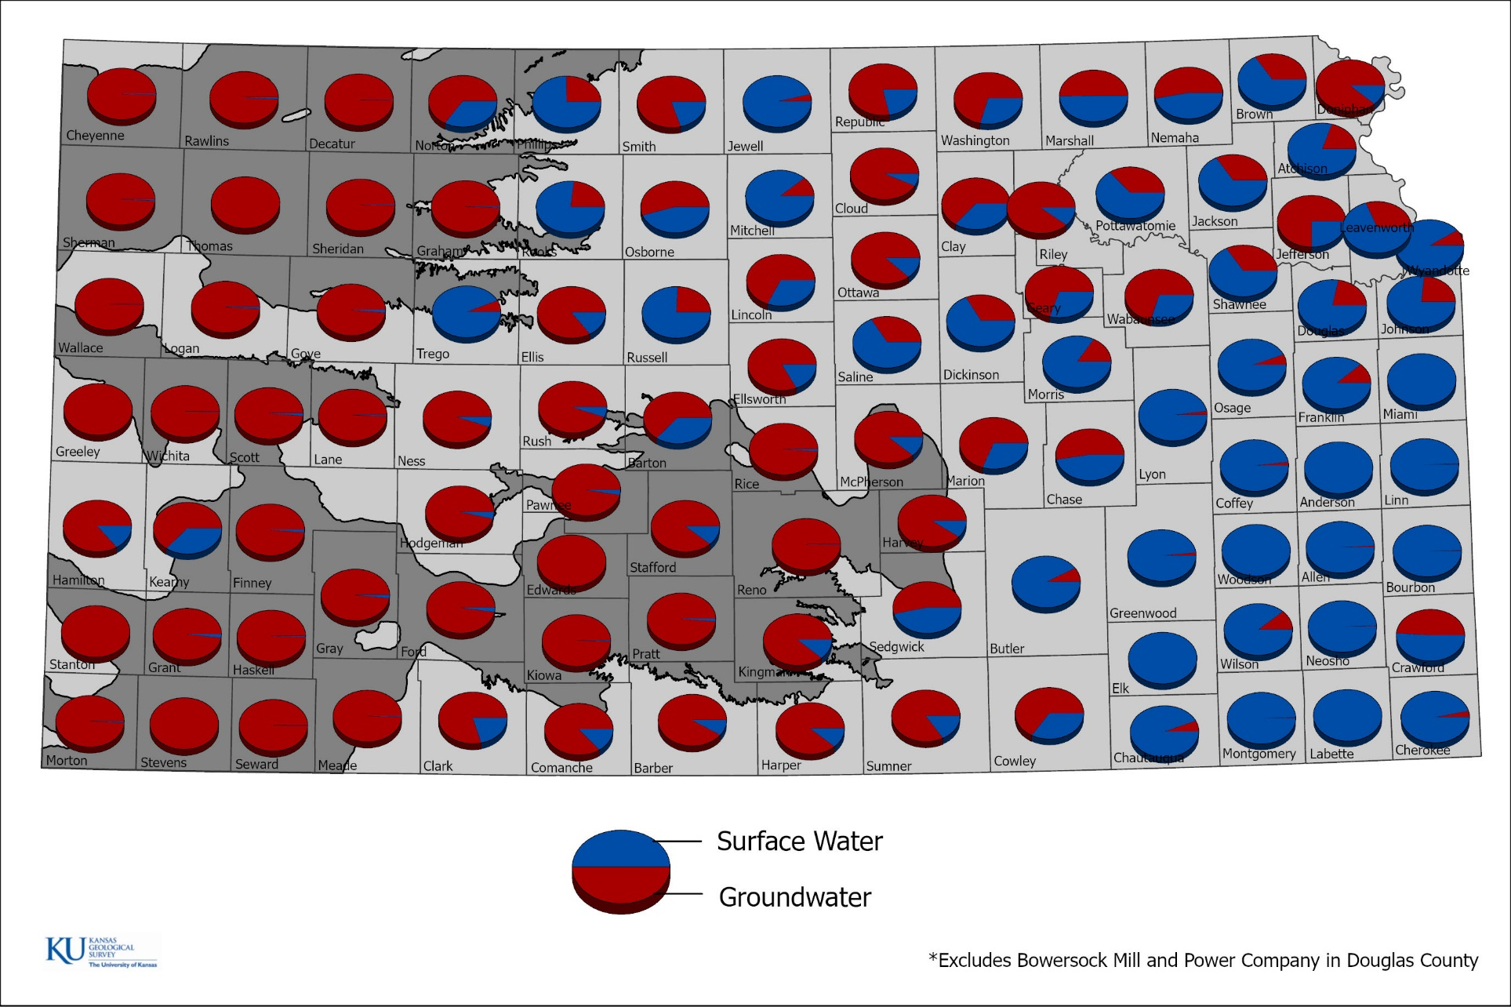
Average Ratio of Authorized Use by Source of Water Supply
Eastern Kansas typically surface water
Western and south-central Kansas typically groundwater
What’s that dark-gray thing in the background????
Kansas Geological Survey

Slide 4
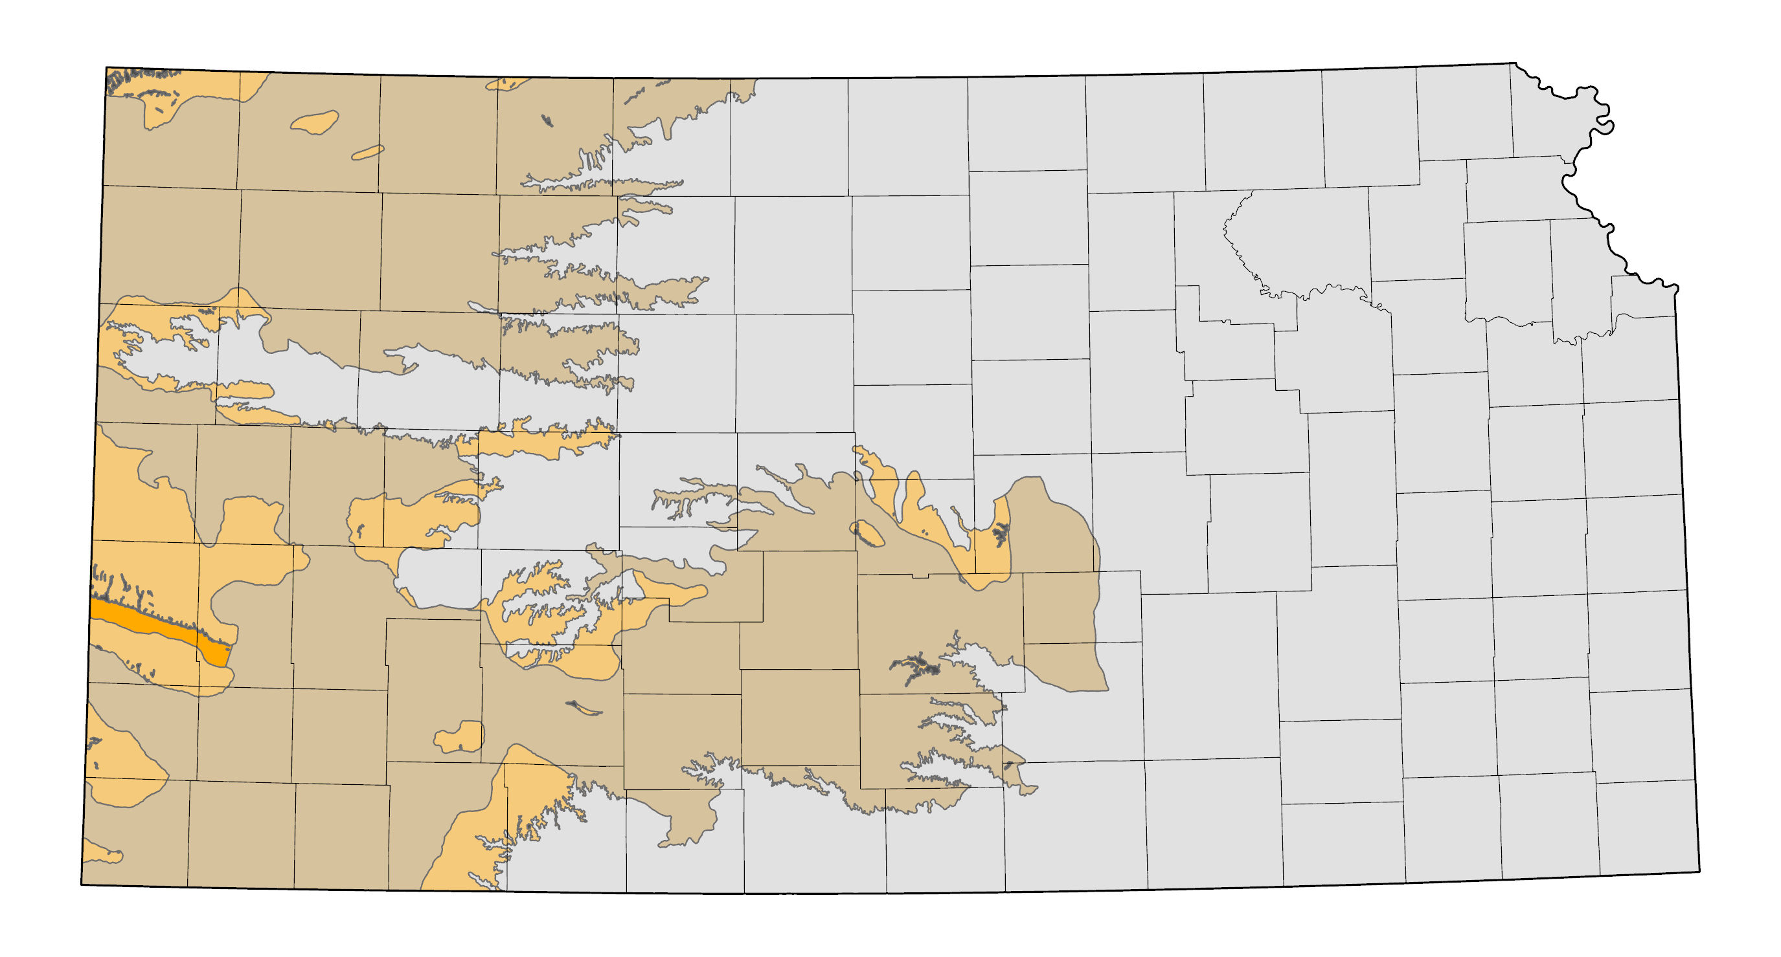
The High Plains Aquifer in Kansas
Equus Beds
Ogallala
Great Bend Prairie
Kansas Geological Survey
Notes:
Proportion of Allocations by Water Source and County. In general, surface water is the primary source in eastern Kansas (blue) and with groundwater in western Kansas (red). The gray shaded area in western and south-central Kansas is the primary saturated extent of the High Plains (HPA) aquifer. The HPA is the primary water source for virtually all uses in this area.

Slide 5
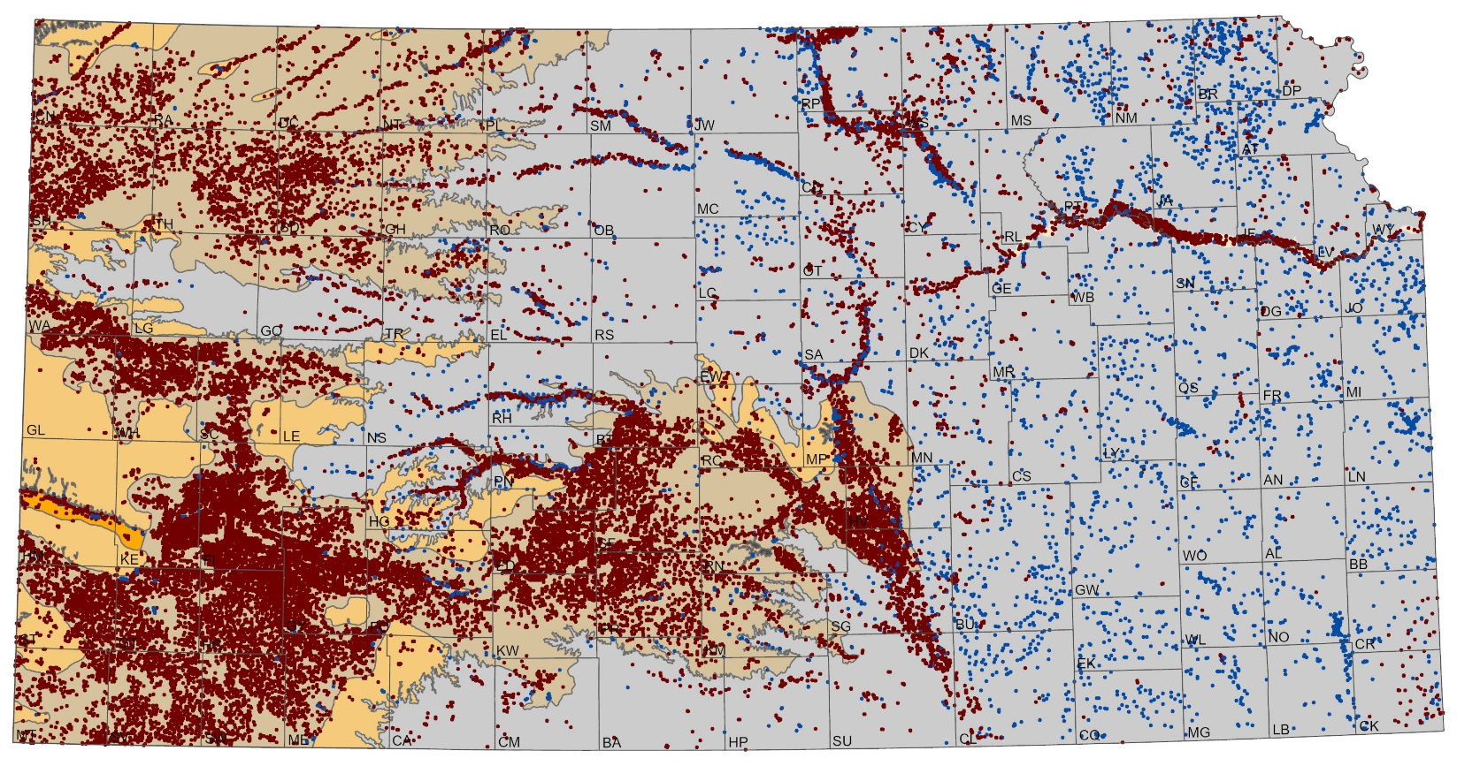
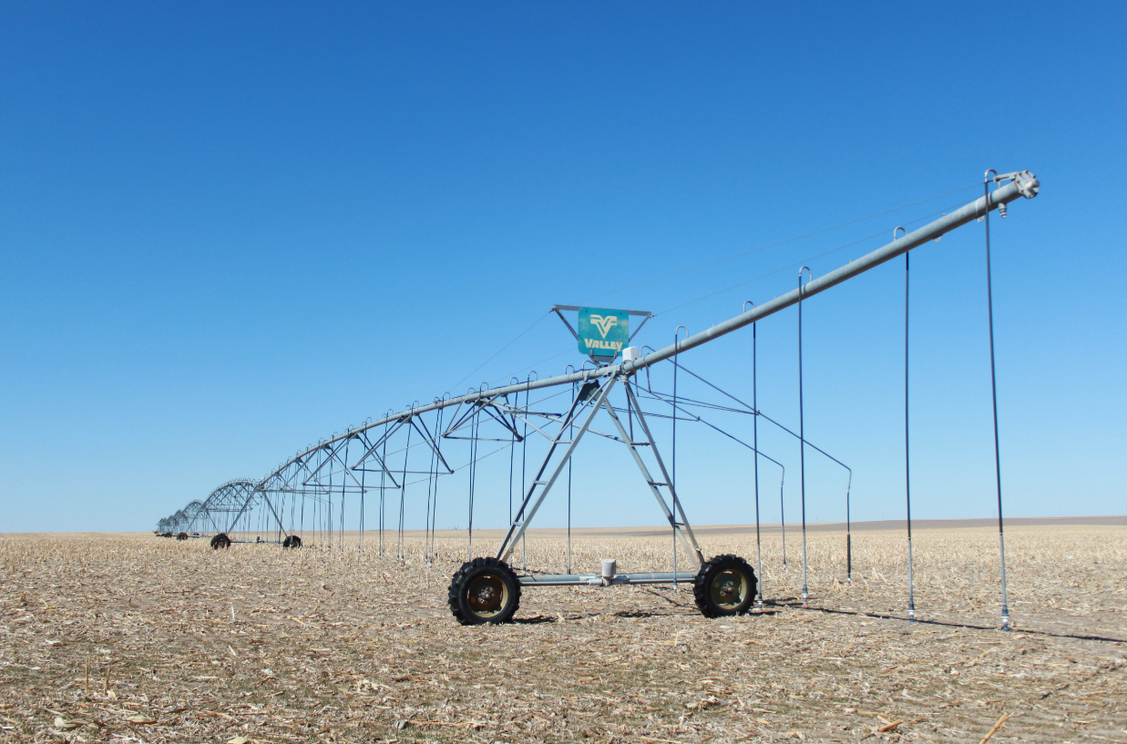
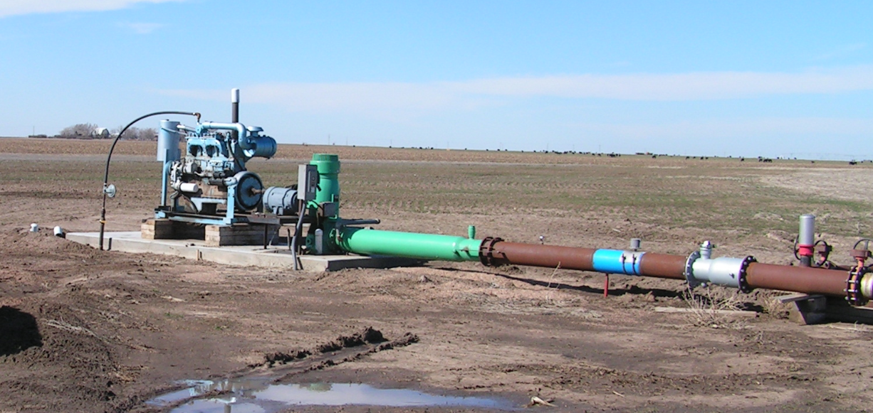
Water Right Development in Kansas
Water usage is highly regulated
Much of the water development in the High Plains aquifer was in place by the 1980s
Each year, ~90% of water used is from groundwater, from that, ~80 to 85% is for irrigation
Over 95% of the wells in the Kansas High Plains aquifer have a flow meter
Kansas Geological Survey
Notes:
The KDA-DWR is charged with administrating the Kansas Water Appropriation Act which requires non-domestic uses of water to obtain a water right / permit. The map shows groundwater-based water rights in red with surface water-based rights in blue. Data on water rights can be obtained online through the WIMAS website at http://hercules.kgs.ku.edu/geohydro/wimas/index.cfm.
Kansas is unique compared to other western states in that water right holders are required to submit annual water use reports. In the HPA, over 95% of the water right wells have totalized flowmeters installed.

Slide 6
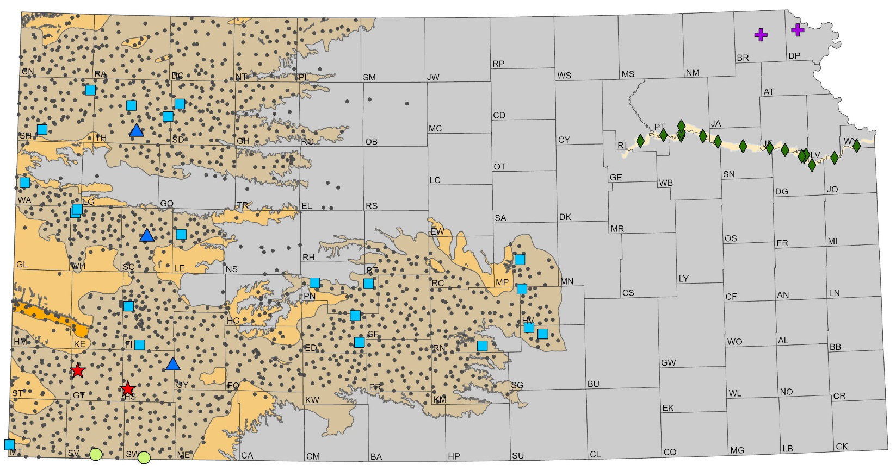
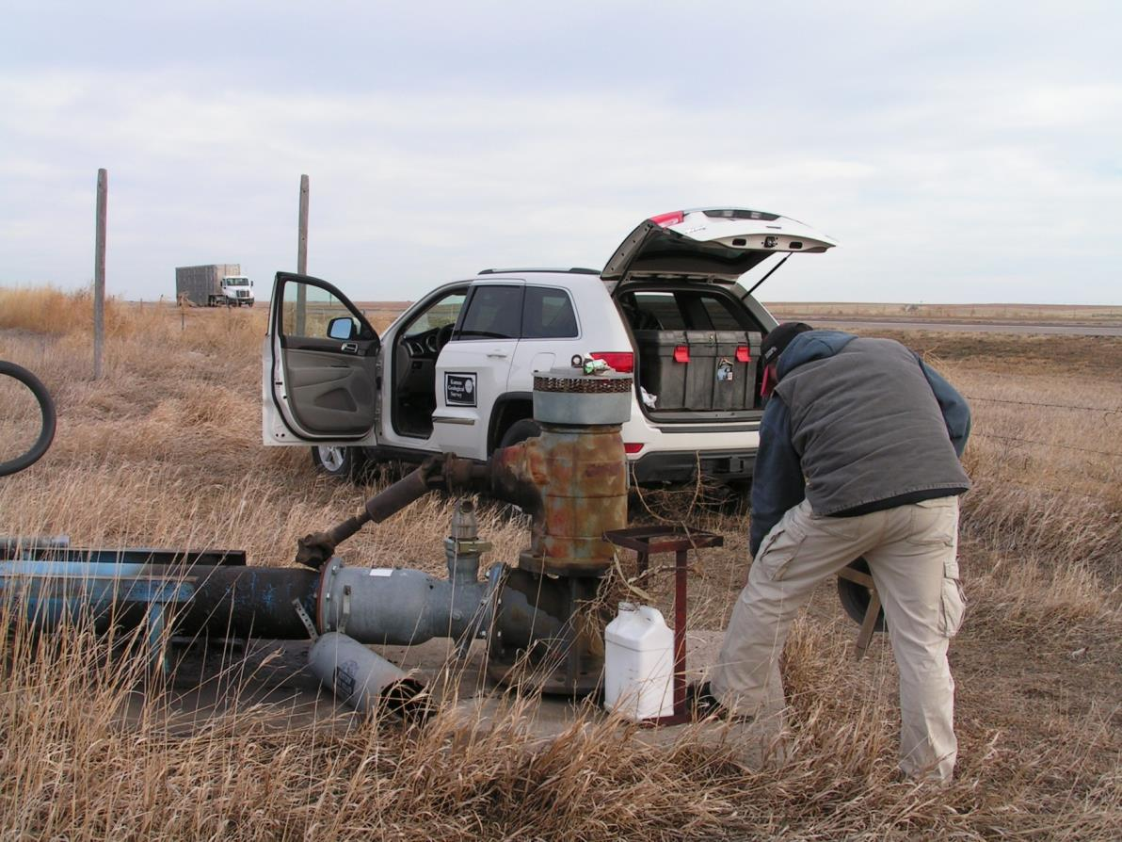
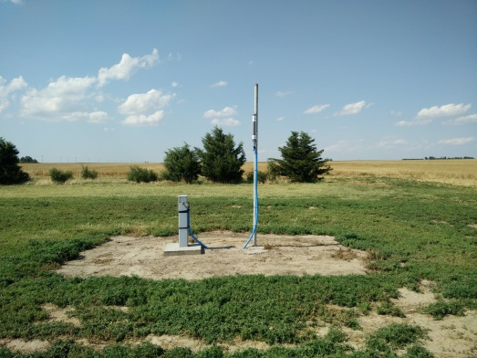
Measuring Wells in Kansas
Depth-to-water measurements
Cooperative Water Level Network
Focused on High Plains aquifer
Annual measurements by the KGS and KDA-DWR
Regional aquifer characterizations
Index Well Network
Continuously measured water levels every hour
Local aquifer conditions throughout the year
Kansas Geological Survey
Notes:
Measured depth to groundwater can be obtained online from the KGS WIZARD database at http://www.kgs.ku.edu/Magellan/WaterLevels/index.html. WIZARD contains data collected from a local, state, and federal agency with the black dots indicating wells measured at some point over the last 20 year. The red stars represent wells included in the Kansas Cooperative Water-Level Measurement Network where each winter, the KGS and KDA-DWR measure roughly 1400 wells to assess regional trends and conditions in the High Plains aquifer region.

Slide 7
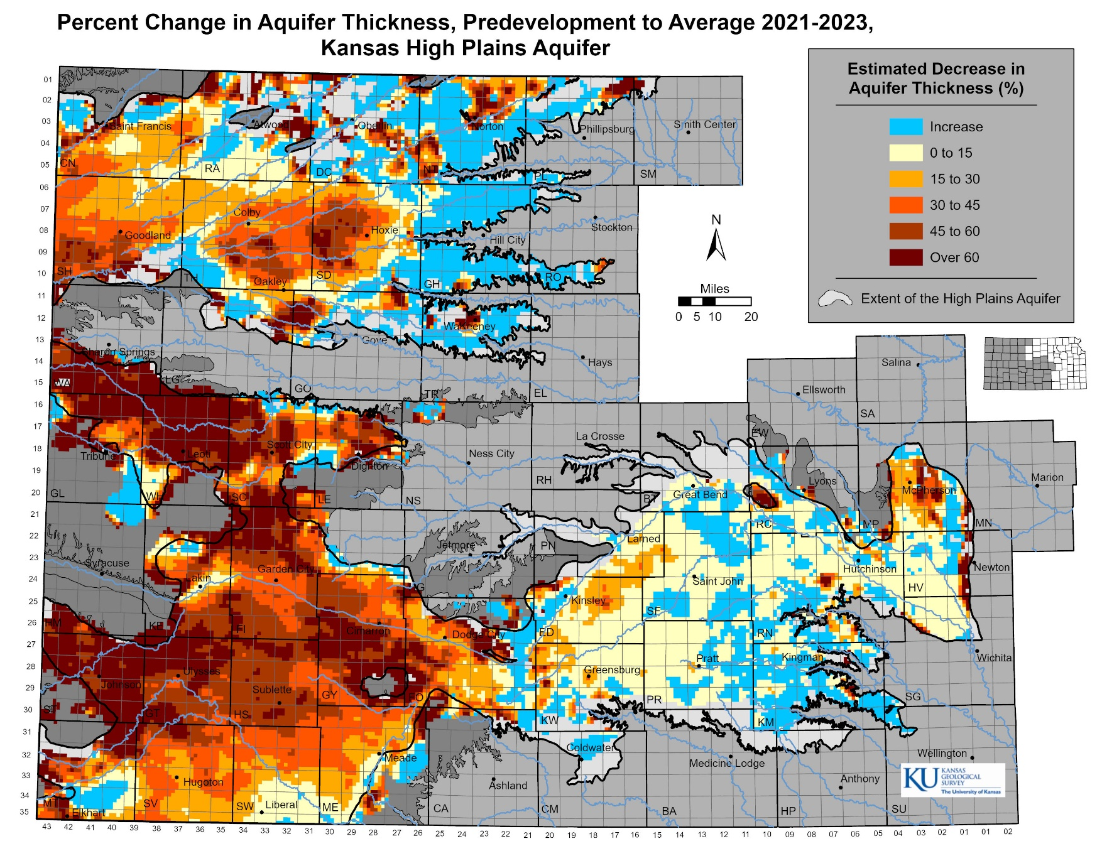
Percent Change from Predevelopment to Present
Western 1/3 of Kansas
Ogallala portion of High Plains aquifer
Relatively deeper, semi-arid climate, lower recharge rates
Typically experiences groundwater declines
South-central Kansas
Great Bend Prairie and Equus Beds regional aquifers
Closer to land surface, more responsive to recharge events
Localized declines
Challenges with stream-aquifer interactions and water quality
Kansas Geological Survey

Slide 8
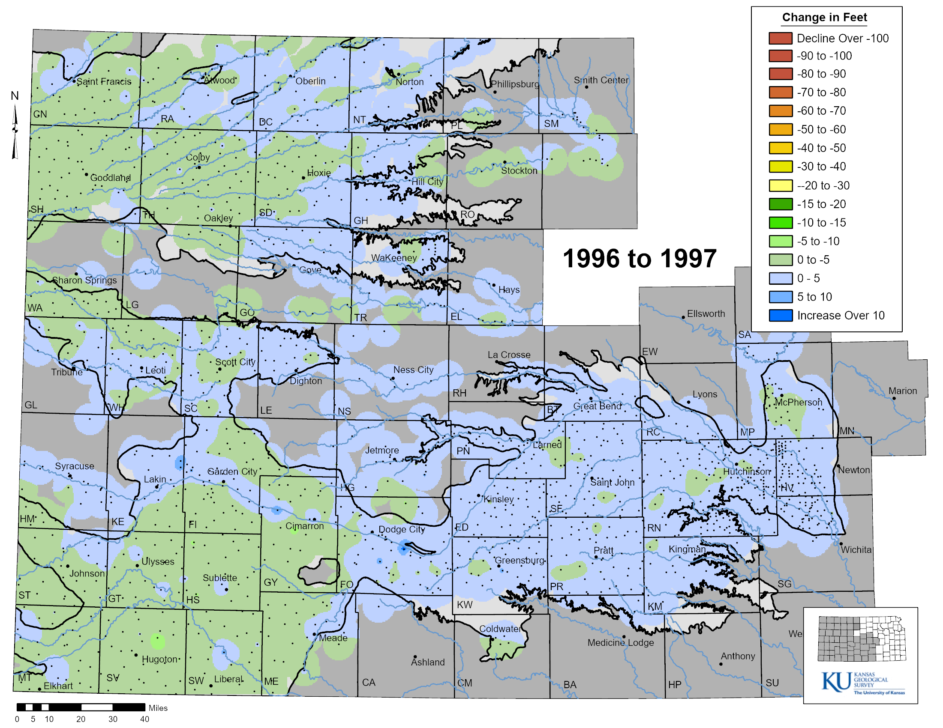
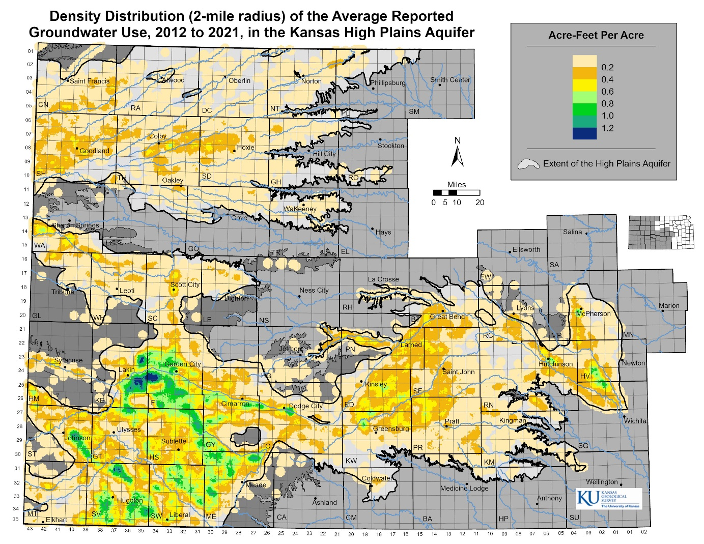
Water-Level Change vs Reported Water Use
Water-Level Change
Groundwater Use
How far out of whack are we?
Kansas Geological Survey
Notes:
The map on the left is an animation of water level changes across the HPA region. Groundwater declines are more prevalent in Ogallala portion of the HPA where annual pumping typically exceeds natural recharge rates. Rainfall, especially over the growing season from April to September, greatly effects groundwater pumping, which in turn, has the greatest influence on decline rates in the Ogallala. The map on the right shows the density of average reported groundwater usage over the HPA. Areas of high water use often correspond to areas of greater groundwater declines. The question is- how far out of proportion is water use versus water declines (e.g., “whack”)?

Slide 9
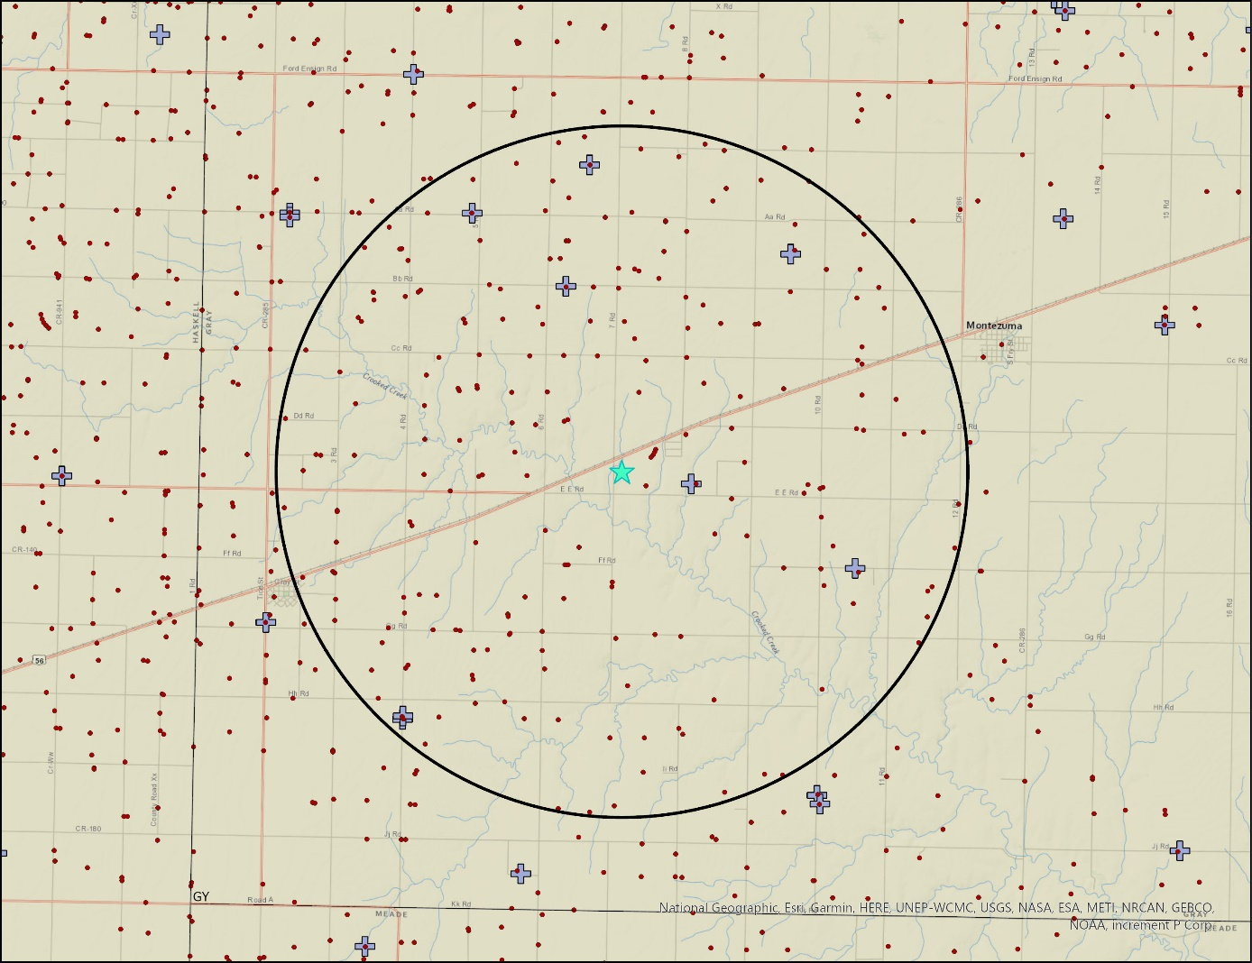
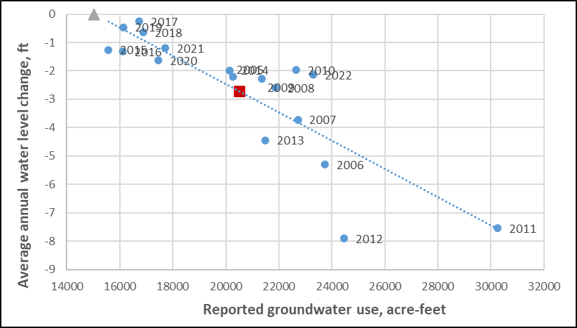
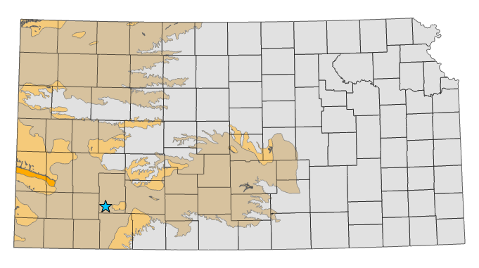
Hy-Plains Feedyard LLC
Reported water use and measured water levels, 2005 to 2022
R-squared = 0.72, P = 0.000009
Average water level change = -2.72 ft
Average total reported use = 20,490 AF
Percent reduction for stable water levels:
Average conditions = 27%
Wet (2017) = 10%
Drought (2011) = 53%
Kansas Geological Survey

Slide 10
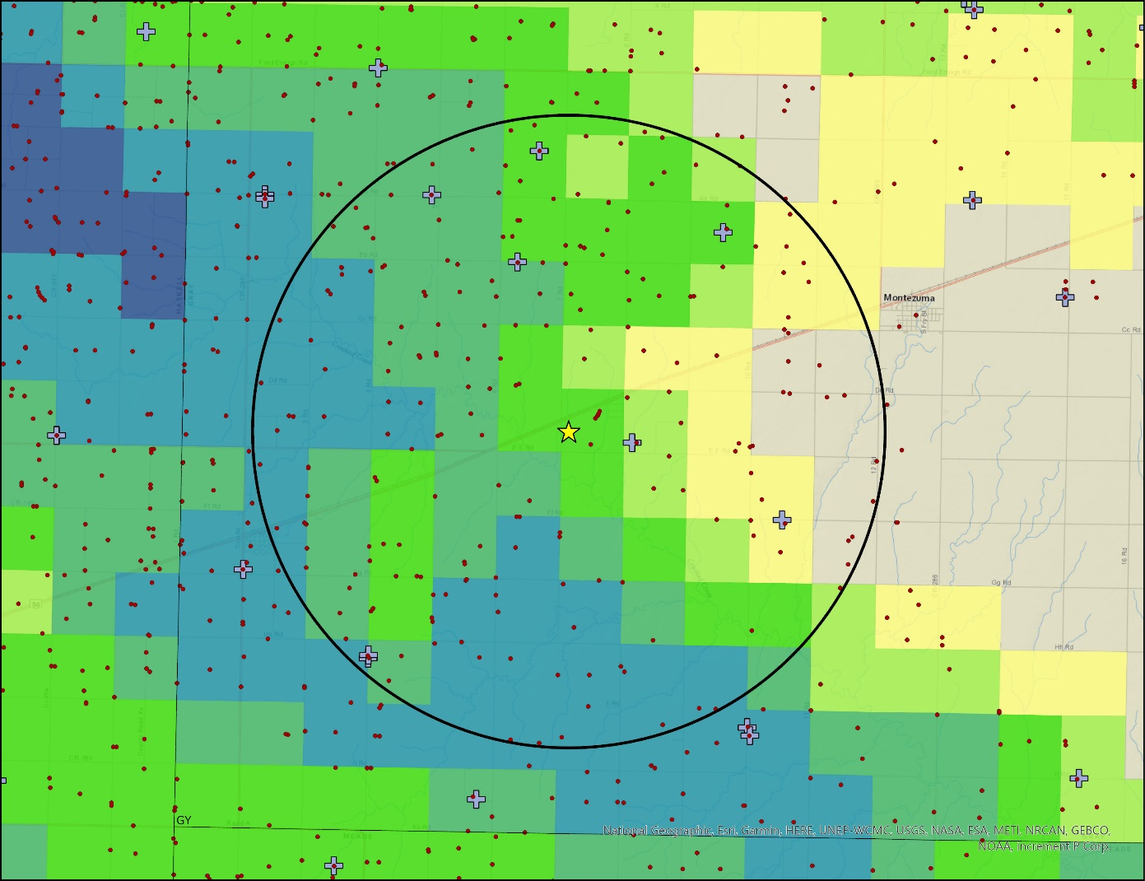
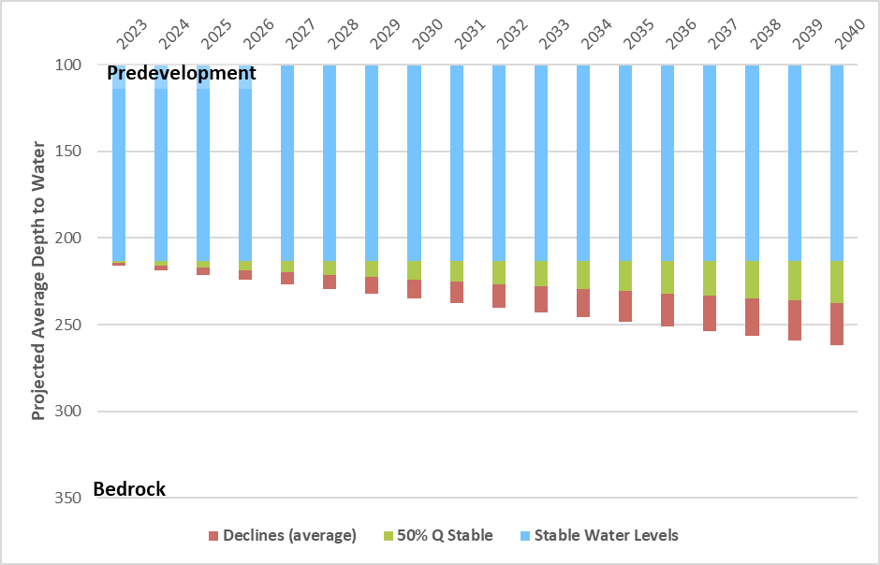
Hy-Plains Feedyard LLC
Projected Water Levels in Feet
Kansas Geological Survey

